Slide 1
Focal Point Analysis
June 24, 2022
Ally Burke

Slide 2
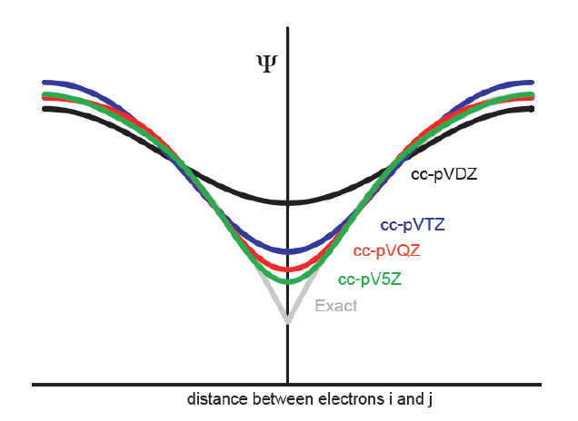
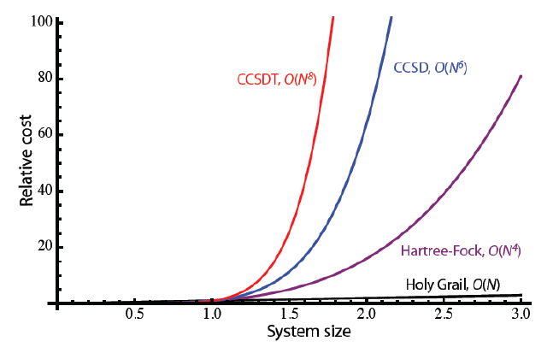
Review/Background
Electron correlation is necessary for chemical accuracy
Highly correlated methods are expensive
Large basis sets are needed to describe electron correlation properly
Why not use a lot of correlation with a large basis set?

Slide 3
Focal Point Analysis (FPA)
Basis set extrapolation method
How does it work
Optimize geometries
Compute single point energies of varying levels of correlation and basis set size
Extrapolate energies to complete basis set (CBS) limit
Compute focal point analysis table
Let’s work through an example
A. G. Császár, W. D. Allen and H. F. Schaefer III, J. Chem. Phys., 1998, 108, 9751–9764
A. L. L. East and W. D. Allen, J. Chem. Phys., 1993, 99, 4638–4650

Slide 4
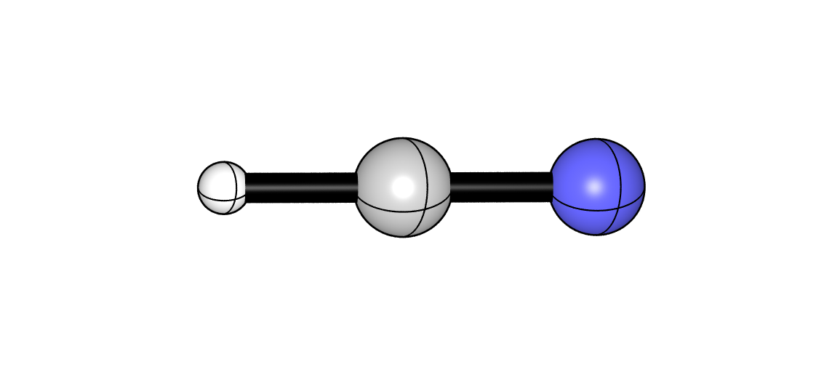
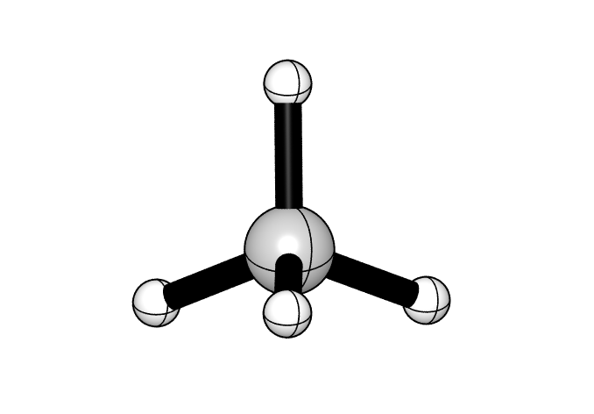
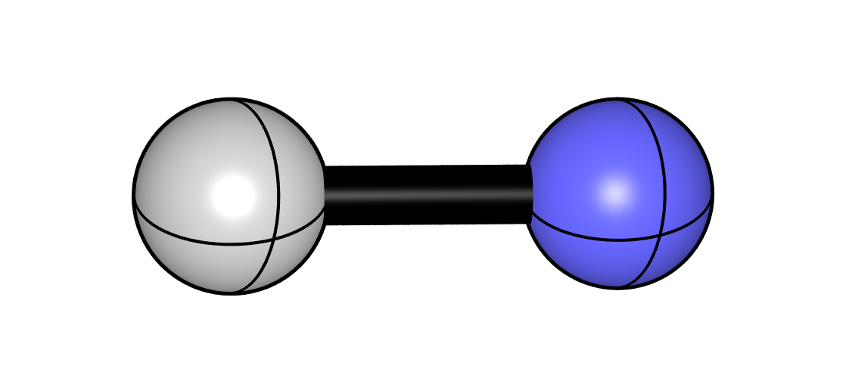
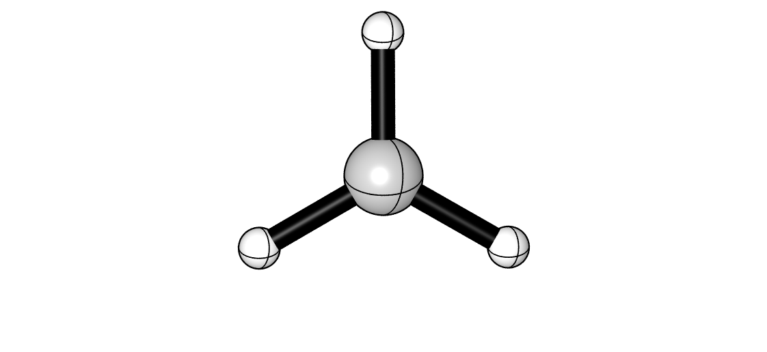
1. Optimize geometries
Goal: obtain energy of products relative to the reactants
Example: CN + CH₄ -> HCN + CH₃ , optimized with CCSD(T)-F12a/aug-cc-pVTZ

Slide 5
2. Compute single point energies
Reactant Energies (Eh): CN + CH₄
Product Energies (Eh): HCN + CH₃
X | HF | MP2 | CCSD | CCSD(T) | CCSDT | CCSDT(Q)
D | -132.3995142 | -132.8458498 | -132.8795884 | -132.8993518 | -132.9007816 | -132.9026771
T | -132.4316236 | -132.9613658 | -132.9865142 | -133.0136659 | […] | […]
Q | -132.4397179 | -132.9978220 | -133.0166032 | -133.0453975 | […] | […]
5 | -132.4414837 | -133.0106458 | -133.0255636 | -133.0549383 | […] | […]
CBS | […] | […] | […] | […] | […] | […]
X | HF | MP2 | CCSD | CCSD(T) | CCSDT | CCSDT(Q)
D | -132.4488739 | -132.8803454 | -132.9111731 | -132.9279156 | -132.9285595 | -132.9302047
T | -132.4821852 | -132.9982579 | -133.0211793 | -133.0447644 | […] | […]
Q | -132.4900220 | -133.0349515 | -133.0516548 | -133.0767771 | […] | […]
5 | -132.4917821 | -133.0478511 | -133.0607193 | -133.0863777 | […] | […]
CBS | […] | […] | […] | […] | […] | […]

Slide 6
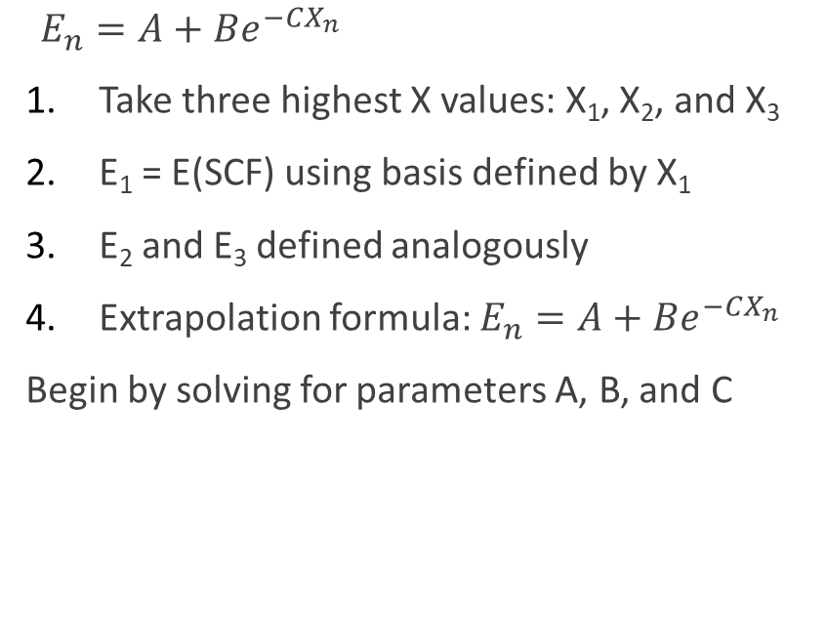
3. Extrapolate energies: SCF Energy
$E_{n}=A+Be^{−CX_{n}}$
Take three highest X values: X₁, X₂, and X₃
E₁ = E(SCF) using basis defined by X₁
E₂ and E₃ defined analogously
Extrapolation formula: $E_{n}=A+Be^{−CX_{n}}$
Begin by solving for parameters A, B, and C
X | HF
D | -132.3995142
X1: T | E1: -132.4316236
X2: Q | E2: -132.4397179
X3: 5 | E3: -132.4414837
CBS | […]

Slide 7

3. Extrapolate energies: SCF Energy
$E_{n}=A+Be^{−CX_{n}}$
Take three highest X values: X₁, X₂, and X₃
E₁ = E(SCF) using basis defined by X₁
E₂ and E₃ defined analogously
Extrapolation formula: $E_{n}=A+Be^{−CX_{n}}$
Begin by solving for parameters A, B, and C
Parameter A:
$E_{3}=A+Be^{−CX_{3}}$
$A= E_{3}−$ $Be^{−CX_{3}}$

Slide 8

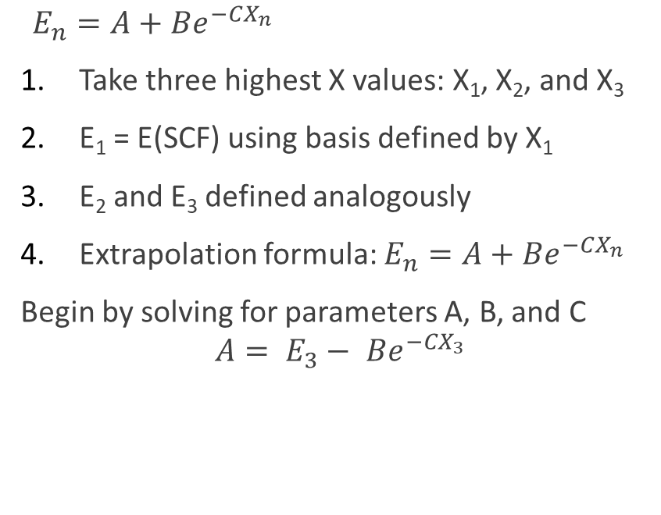
3. Extrapolate energies: SCF Energy
$E_{n}=A+Be^{−CX_{n}}$
Take three highest X values: X₁, X₂, and X₃
E₁ = E(SCF) using basis defined by X₁
E₂ and E₃ defined analogously
Extrapolation formula: $E_{n}=A+Be^{−CX_{n}}$
Begin by solving for parameters A, B, and C
$$A= E_{3}− Be^{−CX_{3}}$$
Parameter B:
$E_{2}=A+Be^{−CX_{2}}$
$E_{3}=A+Be^{−CX_{3}}$
$E_{3}−E_{2}=B\left(e^{−CX_{3}}−e^{−CX_{2}}\right)=Be^{−CX_{2}}\left(e^{−C}−1\right)$
$B= \frac{E_{3}−E_{2}}{e^{−CX_{2}}\left(e^{−C}−1\right)}$

Slide 9
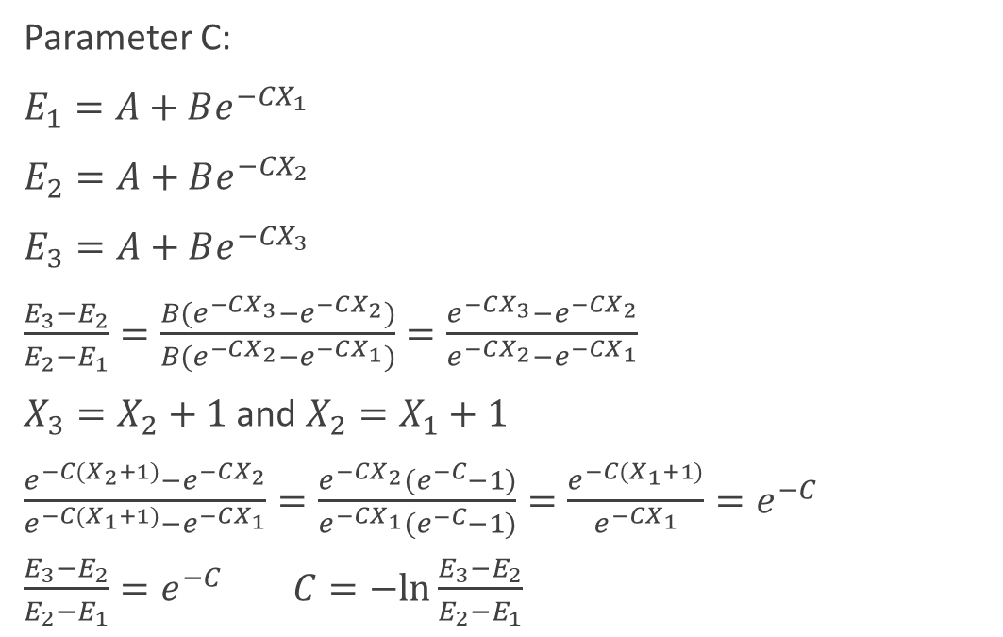
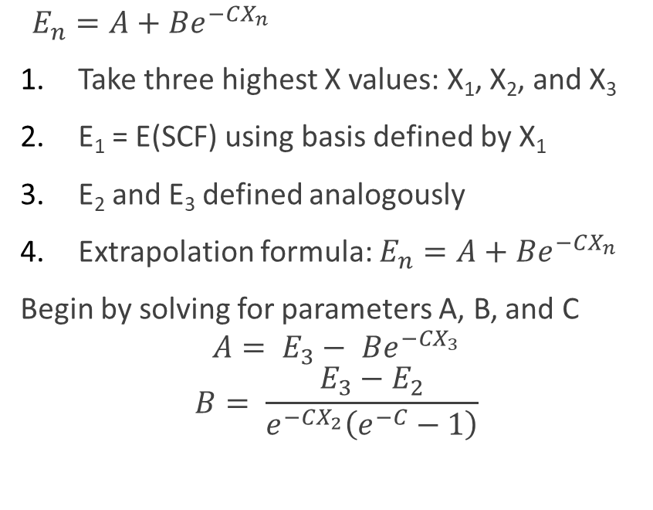
3. Extrapolate energies: SCF Energy
$E_{n}=A+Be^{−CX_{n}}$
Take three highest X values: X₁, X₂, and X₃
E₁ = E(SCF) using basis defined by X₁
E₂ and E₃ defined analogously
Extrapolation formula: $E_{n}=A+Be^{−CX_{n}}$
Begin by solving for parameters A, B, and C
$$A= E_{3}− Be^{−CX_{3}}$$
$$B= \frac{E_{3}−E_{2}}{e^{−CX_{2}}\left(e^{−C}−1\right)}$$
Parameter C:
$E_{1}=A+Be^{−CX_{1}}$
$E_{2}=A+Be^{−CX_{2}}$
$E_{3}=A+Be^{−CX_{3}}$
$\frac{E_{3}−E_{2}}{E_{2}−E_{1}}=\frac{B(e^{−CX_{3}}−e^{−CX_{2}})}{B(e^{−CX_{2}}−e^{−CX_{1}})}=\frac{e^{−CX_{3}}−e^{−CX_{2}}}{e^{−CX_{2}}−e^{−CX_{1}}}$
$X_{3}=X_{2}+1$ and $X_{2}=X_{1}+1$
$\frac{e^{−C(X_{2}+1)}−e^{−CX_{2}}}{e^{−C{(X}_{1}+1)}−e^{−CX_{1}}}=\frac{e^{−CX_{2}}(e^{−C}−1)}{e^{−CX_{1}}(e^{−C}−1)}=\frac{e^{−C(X_{1}+1)}}{e^{−CX_{1}}}=e^{−C}$
$\frac{E_{3}−E_{2}}{E_{2}−E_{1}}=e^{−C}$ $C=−ln⁡\frac{E_{3}−E_{2}}{E_{2}−E_{1}}$

Slide 10
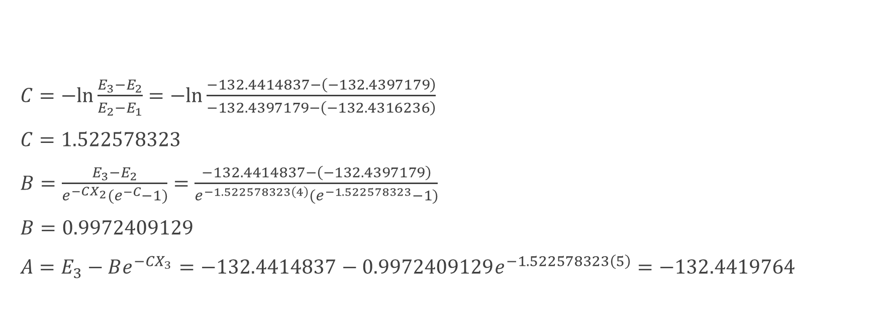
3. Extrapolate energies: SCF Energy
$C=−ln\frac{E_{3}−E_{2}}{E_{2}−E_{1}}=−ln\frac{−132.4414837−\left(−132.4397179\right)}{−132.4397179−\left(−132.4316236\right)}$
$C=1.522578323$
$B=\frac{E_{3}−E_{2}}{e^{−CX_{2}}(e^{−C}−1)}=\frac{−132.4414837−\left(−132.4397179\right)}{e^{−1.522578323\left(4\right)}(e^{−1.522578323}−1)}$
$B=0.9972409129$
$A=E_{3}−Be^{−CX_{3}}=−132.4414837−0.9972409129e^{−1.522578323\left(5\right)}=−132.4419764$
X | HF
D | -132.3995142
T | -132.4316236
Q | -132.4397179
5 | -132.4414837
CBS | [-132.4419764]

Slide 11
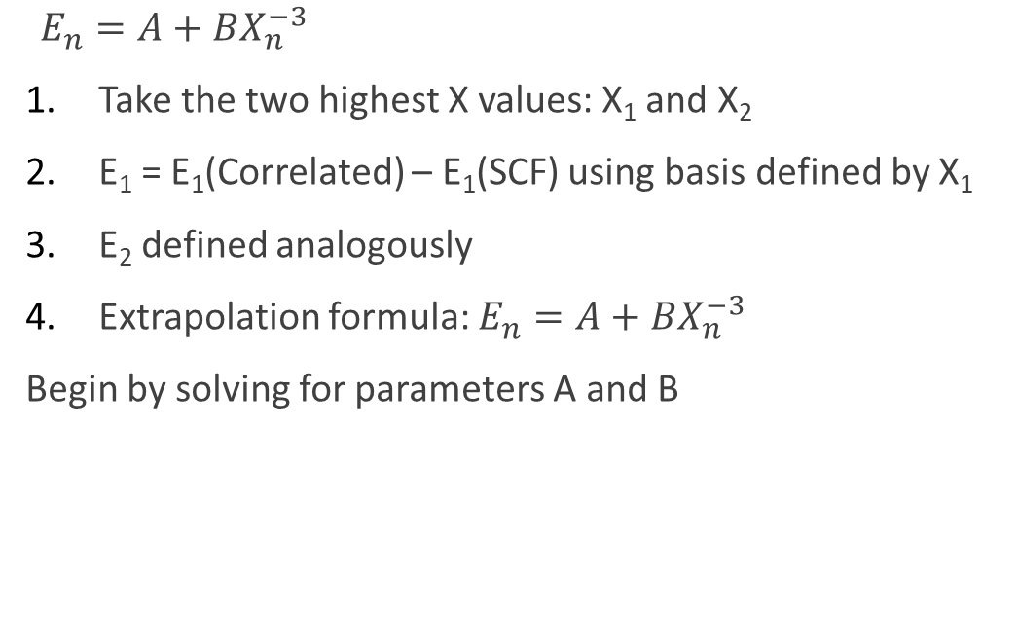
3. Extrapolate energies: Correlation Energy
$E_{n}=A+BX_{n}^{−3}$
Take the two highest X values: X₁ and X₂
E₁ = E₁(Correlated) – E₁(SCF) using basis defined by X₁
E₂ defined analogously
Extrapolation formula: $E_{n}=A+BX_{n}^{−3}$
Begin by solving for parameters A and B
X | HF | MP2
D | -132.3995142 | -132.8458498
T | -132.4316236 | -132.9613658
X1: Q | -132.4397179 | -132.9978220
X2: 5 | -132.4414837 | -133.0106458
CBS | [-132.4419764] | […]

Slide 12

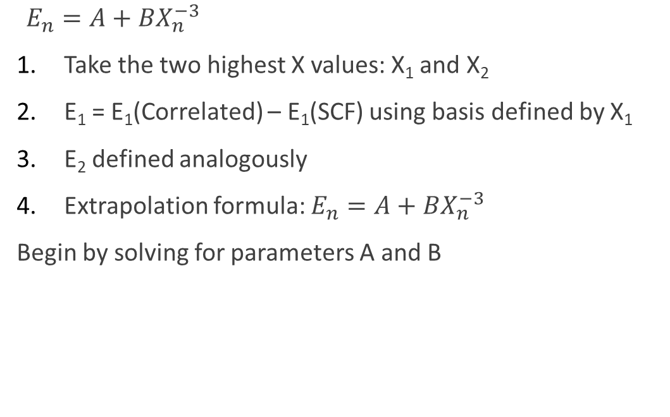
3. Extrapolate energies: Correlation Energy
$E_{n}=A+BX_{n}^{−3}$
Take the two highest X values: X₁ and X₂
E₁ = E₁(Correlated) – E₁(SCF) using basis defined by X₁
E₂ defined analogously
Extrapolation formula: $E_{n}=A+BX_{n}^{−3}$
Begin by solving for parameters A and B
Parameter A:
$E_{2}=A+BX_{2}^{−3}$
$A= E_{2}−BX_{2}^{−3}$

Slide 13
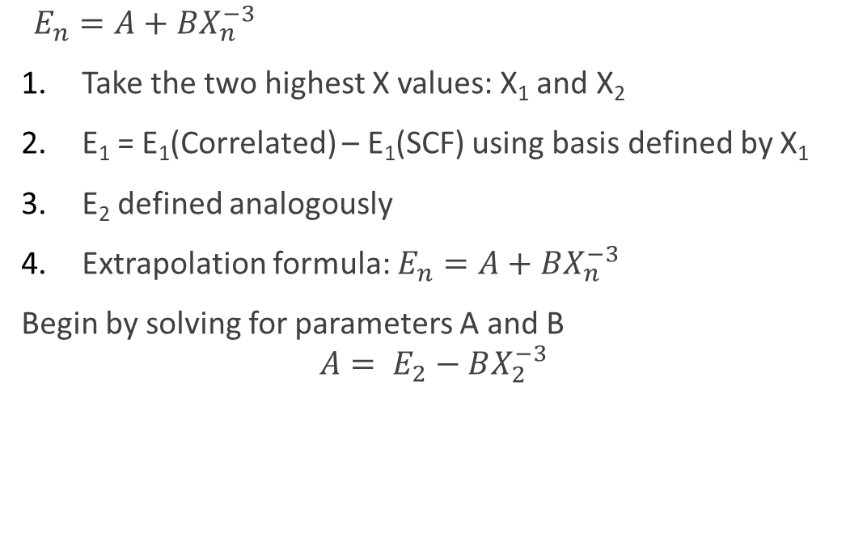

3. Extrapolate energies: Correlation Energy
$E_{n}=A+BX_{n}^{−3}$
Take the two highest X values: X₁ and X₂
E₁ = E₁(Correlated) – E₁(SCF) using basis defined by X₁
E₂ defined analogously
Extrapolation formula: $E_{n}=A+BX_{n}^{−3}$
Begin by solving for parameters A and B
$$A= E_{2}−BX_{2}^{−3}$$
Parameter B:
$E_{1}=A+BX_{1}^{−3}$
$E_{2}=A+BX_{2}^{−3}$
$E_{2}−E_{1}=B(X_{2}^{−3}−X_{1}^{−3})$
$B= \frac{E_{2}−E_{1}}{X_{2}^{−3}−X_{1}^{−3}}$

Slide 14
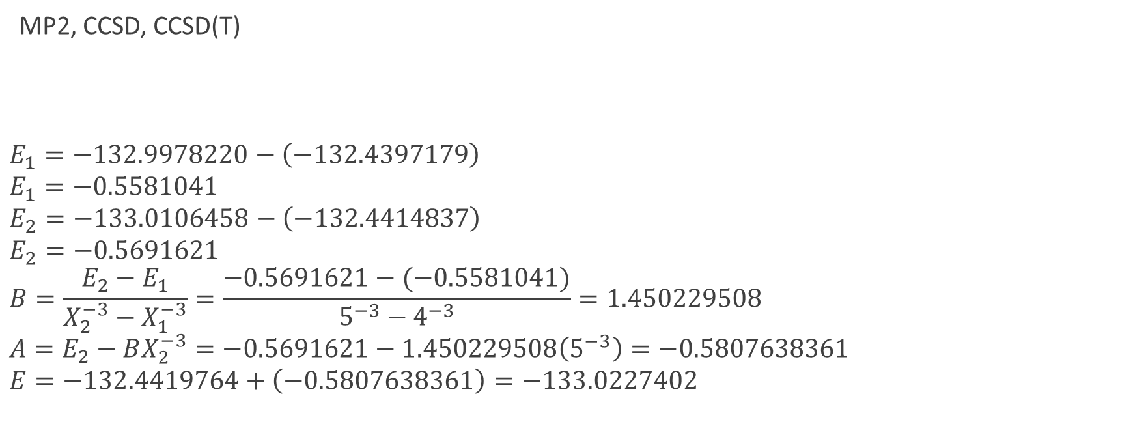
3. Extrapolate energies: Correlation Energy
MP2, CCSD, CCSD(T)
$$E_{1}=−132.9978220−\left(−132.4397179\right)$$
$$E_{1}=−0.5581041$$
$$E_{2}=−133.0106458−\left(−132.4414837\right)$$
$$E_{2}=−0.5691621$$
$$B=\frac{E_{2}−E_{1}}{X_{2}^{−3}−X_{1}^{−3}}=\frac{−0.5691621−(−0.5581041)}{5^{−3}−4^{−3}}=1.450229508$$
$$A=E_{2}−BX_{2}^{−3}=−0.5691621−1.450229508\left(5^{−3}\right)=−0.5807638361$$
$$E=−132.4419764+\left(−0.5807638361\right)=−133.0227402$$
X | HF | MP2
D | -132.3995142 | -132.8458498
T | -132.4316236 | -132.9613658
Q | -132.4397179 | -132.9978220
5 | -132.4414837 | -133.0106458
CBS | [-132.4419764] | [-133.0227404]

Slide 15
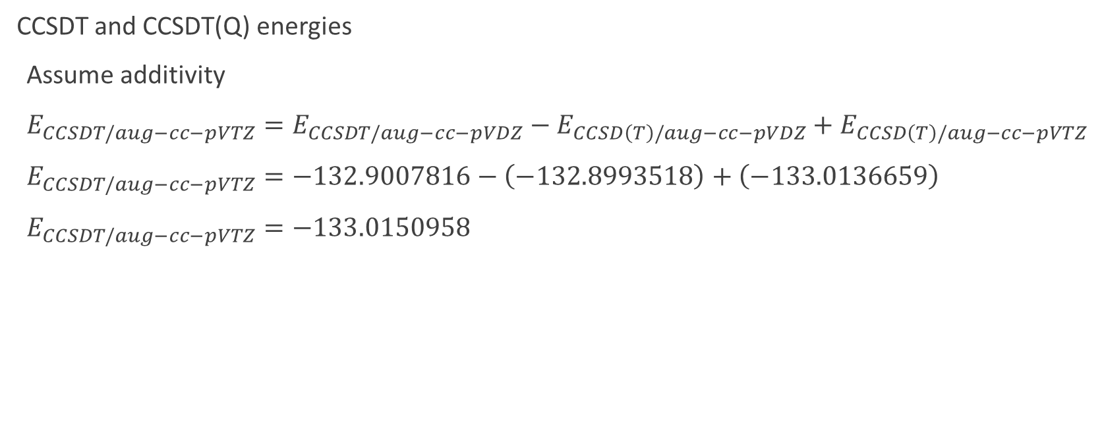
3. Extrapolate energies: Correlation Energy
CCSDT and CCSDT(Q) energies
Assume additivity
$E_{CCSDT/aug−cc−pVTZ}=E_{CCSDT/aug−cc−pVDZ}−E_{CCSD\left(T\right)/aug−cc−pVDZ}+E_{CCSD\left(T\right)/aug−cc−pVTZ}$
$E_{CCSDT/aug−cc−pVTZ}=−132.9007816−\left(−132.8993518\right)+\left(−133.0136659\right)$
$E_{CCSDT/aug−cc−pVTZ}=−133.0150958$
X | CCSD(T) | CCSDT
D | -132.8993518 | -132.9007816
T | -133.0136659 | [-133.0150958]
Q | -133.0453975 | [-133.0468273]
5 | -133.0549383 | [-133.0563681]
CBS | [-133.0635884] | [-133.0650182]

Slide 16
3. Extrapolate energies
Reactant Energies (Eh): CN + CH₄
Product Energies (Eh): HCN + CH3
X | HF | MP2 | CCSD | CCSD(T) | CCSDT | CCSDT(Q)
D | -132.3995142 | -132.8458498 | -132.8795884 | -132.8993518 | -132.9007816 | -132.9026771
T | -132.4316236 | -132.9613658 | -132.9865142 | -133.0136659 | [-133.0150958] | [-133.0169912]
Q | -132.4397179 | -132.9978220 | -133.0166032 | -133.0453975 | [-133.0468273] | [-133.0487228]
5 | -132.4414837 | -133.0106458 | -133.0255636 | -133.0549383 | [-133.0563681] | [-133.0582636]
CBS | [-132.4419764] | [-133.0227404] | [-133.0336049] | [-133.0635884] | [-133.0650182] | [-133.0669136]
X | HF | MP2 | CCSD | CCSD(T) | CCSDT | CCSDT(Q)
D | -132.4488739 | -132.8803454 | -132.9111731 | -132.9279156 | -132.9285595 | -132.9302047
T | -132.4821852 | -132.9982579 | -133.0211793 | -133.0447644 | [-133.0454083] | [-133.0470535]
Q | -132.4900220 | -133.0349515 | -133.0516548 | -133.0767771 | [-133.0774211] | [-133.0790662]
5 | -132.4917821 | -133.0478511 | -133.0607193 | -133.0863777 | [-133.0870217] | [-133.0886669]
CBS | [-132.4922920] | [-133.0600483] | [-133.0688927] | [-133.0951137] | [-133.0957576] | [-133.0974028]

Slide 17
High-level corrections: insensitive to basis set
Assume high-level differences ((Q)-T) are independent of basis set
The corrections are small
Triple excitations correlate three electrons simultaneously, quadruples correlate four, etc.
At the coalescence point of more than 2 electrons, the wavefunction is zero
Smaller probability of more than two electrons being close to each other

Slide 18
4. Compute focal point analysis table
(Products – Reactants) * 627.509474 = FPA table in kcal/mol
HCN + CH₃ CN + CH₄
X | HF
D | -132.4488739
T | -132.4821853
Q | -132.4900220
5 | -132.4917822
CBS | [-132.4922920]
X | HF
D | -132.3995142
T | -132.4316236
Q | -132.4397179
5 | -132.4414837
CBS | [-132.4419764]
X | HF
D | -30.97
T | -31.73
Q | -31.57
5 | -31.56
CBS | [-31.57]
-
* 627.509474
=

Slide 19
4. Compute focal point analysis table
X | HF | MP2 | CCSD | CCSD(T) | CCSDT | CCSDT(Q)
D | -30.97 | -21.65 | -19.82 | -17.92 | -17.43 | -17.27
T | -31.73 | -23.15 | -21.75 | -19.51 | [-19.02] | [-18.86]
Q | -31.57 | -23.30 | -22.00 | -19.69 | [-19.20] | [-19.04]
5 | -31.56 | -23.35 | -22.06 | -19.73 | [-19.24] | [-19.08]
CBS | [-31.57] | [-23.41] | [-22.14] | [-19.78] | [-19.29] | [-19.13]
X | HF | MP2 | CCSD | CCSD(T) | CCSDT | CCSDT(Q) | NET
D | -30.97 | +9.33 | +1.83 | +1.90 | +0.49 | +0.16 | [-17.27]
T | -31.73 | +8.58 | +1.40 | +2.24 | [+0.49] | [+0.16] | [-18.86]
Q | -31.57 | +8.27 | +1.30 | +2.30 | [+0.49] | [+0.16] | [-19.04]
5 | -31.56 | +8.22 | +1.29 | +2.33 | [+0.49] | [+0.16] | [-19.08]
CBS | [-31.57] | [+8.16] | [+1.27] | [+2.36] | [+0.49] | [+0.16] | [-19.13]

Slide 20
Summary
FPA allows us to obtain high level energies that would otherwise be cost-prohibitive
Complete basis set limit at highest correlation level used – no extrapolation of correlation
FPA is cheap and flexible
Level of theory used is application dependent
We have scripts available that do all the math for us
Further reading:
A. G. Császár, W. D. Allen and H. F. Schaefer III, J. Chem. Phys., 1998, 108, 9751–9764
A. L. L. East and W. D. Allen, J. Chem. Phys., 1993, 99, 4638–4650

